Slide 1
Introduction to IES
Based on version 4.1.0

Slide 2
What and why
The UK Government “Information Exchange Standard” is a specification of how to exchange data between interested parties. The scope of the standard has been deliberately left open, but has initially been focussed on information pertinent to defence, policing and national security.
The standard was developed in recognition of the number of point-to-point interfaces that were being developed and maintained in UK Government, few of which conformed to any official data standards. These interfaces tended to be fragile, restricted business agility and were costly to maintain. The IES is a data standard for structured business data, intended to de-couple applications and simplify the application infrastructure.
The standard is designed to be extensible, and is based on a number of re-usable patterns of business. The IES borrows heavily from an existing defence standard (the IDEAS specification) developed between a number of national defence departments in the mid 2000s to enable sharing of enterprise architecture data. IDEAS in turn was based on the BORO methodology and the ISO15926 standard. IES follows the UK Government preferred data exchange approach, using W3C RDF Standard to serialise the data. Use of RDF provides standard formats in JSON and XML, as well as a number of open-source tools for working with the data.
RDF = Resource Definition Framework (data representation standard)
W3C = World Wide Web Consortium (standards body, responsible for http, XML, RDF, etc.)
BORO = Business Objects Re-engineering Ontology (a data modelling method)
IDEAS = International Defence Enterprise Architecture Standard (AUS, CAN, UK, US, SWE, FRA, NATO)
XML = eXtensible markup language (W3C standard for data serialisation)
JSON = JavaScript Object Notation (data serialisation standard)

Slide 3
Usage: Data Exchange
Party A
Party B
System
IES
I/F
IES
I/F
System
IES File
Systems continue to use their own internal data structures, but map to/from the IES format at the system boundary. The intention is to develop IES tooling at open-source to lower the bar to implementation.
I/F = shorthand for “interface”

Slide 4
Usage: Synchronisation
Microservice
Microservice
Microservice
Microservice
Microservice
Microservice
change data capture
change data capture
change data capture
change data capture
change data capture
change data capture
IES I/F
IES I/F
IES I/F
IES I/F
IES I/F
IES I/F
deltas
deltas
deltas
deltas
deltas
deltas
Event Log (aka Distributed Commit Log)
In a microservices architecture where there is extensive replication of data across services (bounded context principle), an event log is used to synchronise the services. Changes in data are written to the log, and picked up by services that subscribe to them. Use of data standards for the messages on the logs is essential to prevent unmanageable data variety.
A distributed commit log holds a sequence of data events (create, modify, delete) in strict temporal order. It allows applications and microservices to subscribe to a stream of events, triggering data events in their own databases and so keeping data synchronised across a wide range of applications and services. Apache Kafka is probably the most widely used.

Slide 5
Usage: Storage
System/Microservice
IES4 Compliant
Database
Although IES was not designed with storage in mind, there has been some interest in using it in that way, especially for applications which bring data together from many sources – i.e. the sink for a number of IES feeds. As IES is an RDF-based standard, the obvious database choice is a triplestore, but some teams have also been looking at implementing just the core IES concepts in document stores such as MongoDB.
Triplestores are graph databases that natively store data as sets of triples or “statements”. These are in the form of subject-predicate-object. As the triples refer to common subjects and objects, a network (or graph) of data is constructed – e.g. A likes B, B is-a Banana, A is-a Fruit-Fly

Slide 6
Architecture
RDF
(a Worldwide Web Consortium standard)
IES
(specified as an ODM UML Model)
Model
Logical
Format
IES RDF
Physical
Format
JSON
XML
Turtle
N3
RDF tools and databases usually provide all the standard serialisation formats (e.g. RDF-JSON, JSON-LD, RDF-XML, etc.) so implementers are encouraged to work with these tools rather than writing their own serialisers/de-serialisers. Working at the logical RDF level rather than the physical format is easier and will result in better quality exchanges of data.

Slide 7
Data Model Approach
The IES uses the W3C’s RDF architecture so it doesn’t have to worry about implementation – all that is already standardised. Instead, the IES specification concentrates on the data model (ontology). This is a logical model defining the types of things (elements) that can be exchanged, how those things can be related, and what properties they can have.
For example, IES specifies that there are people and there are locations. It also says that people can have names, and that they can be in locations*. This is all done using a diagram notation called UML**
*Temporally – IES is smart enough to know that things can move
**Strictly speaking, it’s using the ODM profile for UML…more on that later

Slide 8
Model Overview
Foundation
entities, events, states, relationships, attributes, measures, time, identifiers
Key Concepts
IES4
person, organisation, location, asset, account, document, travel, meetings, trade, communication, finance, etc.
Domain Concepts
e.g. military, political, criminal, communications devices, real estate, vehicles, law enforcement, etc.
Local Extensions
always extending from the layer above to ensure maximum amount of understanding – i.e. you don’t just add a new concept, you extend from the lowest point possible

Slide 9
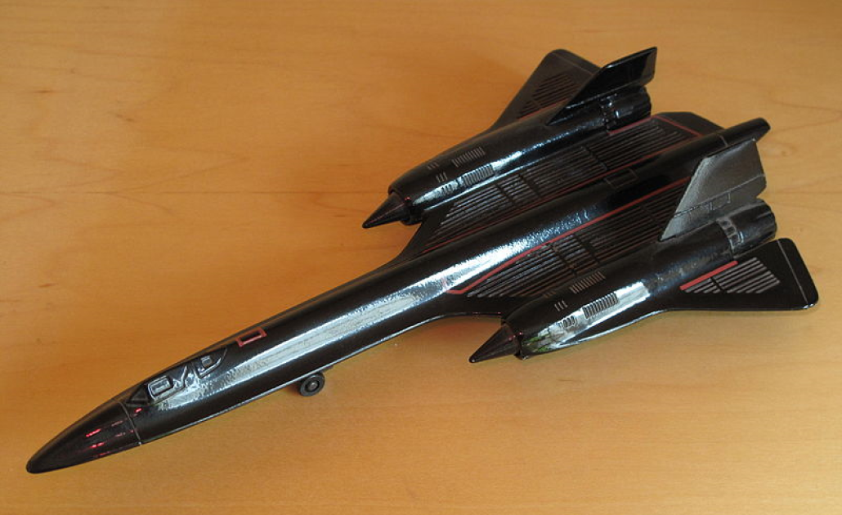
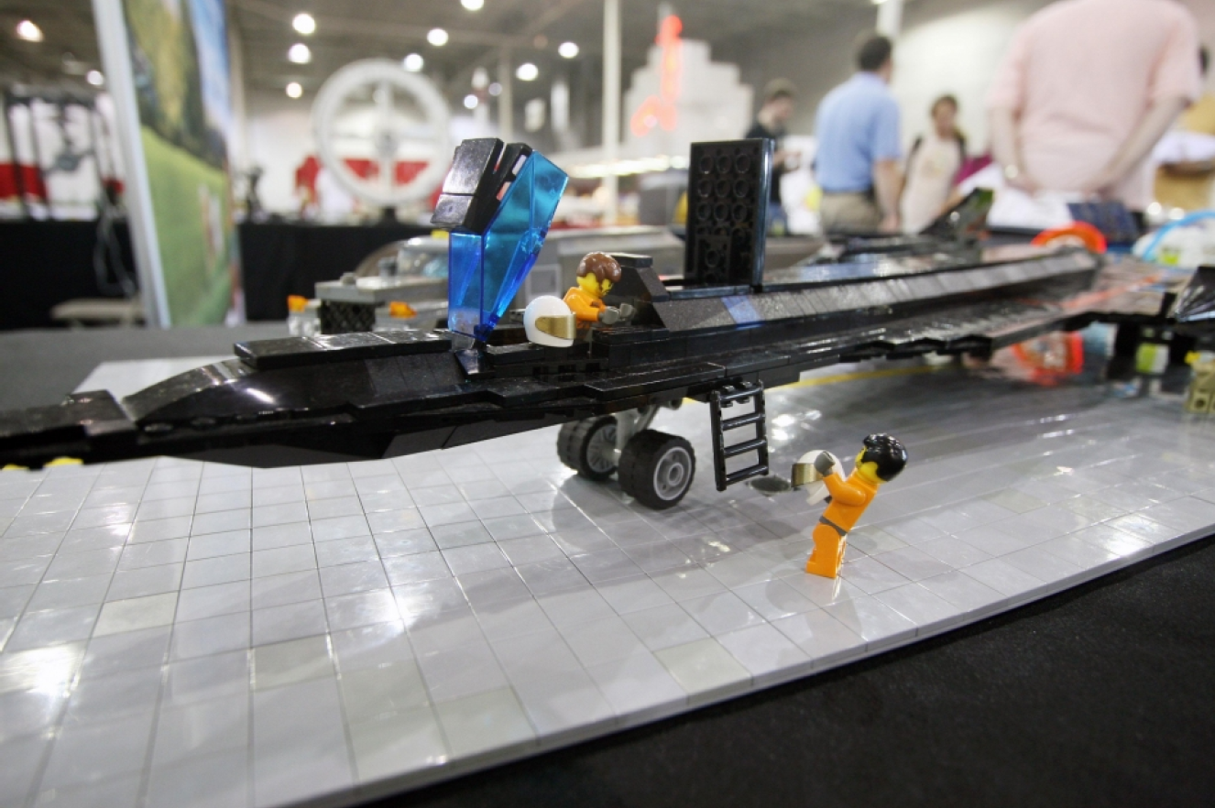
Lego™ not Airfix™ *
IES is not like a traditional data model. It is made up of a few re-usable components that you put together in different ways to make your model. It’s like Lego™ - the model might not exactly as you expected, but the parts move, and you can always change and extend it easily. You can also change small parts without breaking the rest of the model…
…I think that’s enough metaphor stretching for one day…
Image wikimedia commons, author:Tangopaso
Image creative commons, NASA, Maria Werries
*Airfix is a UK model kit company – similar to Revell™, Heller™ or Tamiya™.

Slide 10
Model Notation
The model is authored using the OMG’s ODM profile for UML. This allows us to export the model as RDF Schema, a Word document and a website all from one Sparx EA model.
«rdfsClass»
Element
«rdfsSubClassOf»
«rdfsClass»
«rdfsClass»
«rdfsClass»
«rdfsClass»
Entity
State
Event
PeriodOfTime
The ODM stereotypes (shown in chevrons <<>>) signify the underlying RDF Schema type – e.g Entity is an rdfs:Class. We also chose to keep the colour coding that had been used in previous IES version – e.g. yellow for entities, pink for events, etc.
OMG = Object Management Group (standards body)
UML = Unified Modelling Language (published by OMG)
ODM = Ontology Definition Metamodel (an extension to UML, published by OMG)

Slide 11
Digression - RDF
RDF is a standard format for graph data – i.e. data that is highly connected. The standard is published by the W3C, and is the UK Government preferred data standard.
It follows a structure of subject-predicate-object:
Fred worksFor Acme
Fred hasName “Fred Smith”
Acme inLocation Birmingham
Fred livesIn Coventry
Coventry partOf UK
Birmingham partOf UK
Fred
Acme
“Fred Smith”
hasName
worksFor
livesIn
inLocation
Coventry
Birmingham
partOf
partOf
Skip this, if you already know about RDF.
Some things to note.
This is a simplified example
it’s not IES compliant
The object can be a literal – in this case “Fred Smith”
The nodes need to be URIs (see next slide)
UK

Slide 12
Digression – RDF URIs
Nodes in an RDF graph have URIs (i.e. http://blah...)
The edges (links) are typed by URIs too
<http://data.gov.uk/example#Fred> <http://data.gov.uk/myOntology#worksFor> <http://data.gov.uk/example#Acme> .
<http://data.gov.uk/example#Fred> <http://data.gov.uk/myOntology#hasName> “Fred Smith” .
<http://data.gov.uk/example#Acme> <http://data.gov.uk/myOntology#inLocation> <http://data.gov.uk/example#Birmingham> .
<http://data.gov.uk/example#Fred> <http://data.gov.uk/myOntology#livesIn> <http://data.gov.uk/example#Coventry> .
<http://data.gov.uk/example#Coventry> <http://data.gov.uk/myOntology#partOf> <http://data.gov.uk/example#UK> .
<http://data.gov.uk/example#Birmingham> <http://data.gov.uk/myOntology#partOf> <http://data.gov.uk/example#UK> .
We can make this a bit easier to read using namespaces:
@prefix ont: <http://data.gov.uk/myOntology#> .
@prefix data: <http://data.gov.uk/example#> .
data:Fred ont:worksFor data:Acme .
data:Fred ont:hasName “Fred Smith” .
data:Acme ont:inLocation data:Birmingham .
data:Fred ont:livesIn data:Coventry .
data:Coventry ont:partOf data:UK .
data:Birmingham ont:partOf data:UK .
The two examples above are valid RDF based on the N-Triples serialisation format. There are other standard ways to serialise RDF, including XML and JSON.

Slide 13
Digression – RDF Schema
You can also define data schemas for RDF data using RDF-Schema (rdfs).
RDF Schema is also defined using RDF.
There are classes (rdfs:Class), relationship definitions (rdf:Property), subtype relationships (rdfs:subClassOf) and type-instance relationships (rdf:type)
@prefix ont: <http://data.gov.uk/myOntology#> .
@prefix rdf: <http://www.w3.org/1999/02/22-rdf-syntax-ns#> .
@prefix rdfs: <http://www.w3.org/2000/01/rdf-schema#> .
ont:Person rdf:type rdfs:Class .
ont:Organisation rdf:type rdfs:Class .
ont:Location rdf:type rdfs:Class .
ont:worksFor rdf:type rdf:Property .
ont:hasName rdf:type rdf:Property .
ont:inLocation rdf:type rdf:Property .
ont:livesIn rdf:type rdf:Property .
ont:partOf rdf:type rdf:Property .
@prefix ont: <http://data.gov.uk/myOntology#> .
@prefix data: <http://data.gov.uk/example#> .
data:Fred rdf:type ont:Person .
data:Fred ont:worksFor data:Acme .
data:Fred ont:worksFor data:Acme .
data:Fred ont:hasName “Fred Smith” .
data:Acme rdf:type ont:Organisation .
data:Acme ont:inLocation data:Birmingham .
data:Fred ont:livesIn data:Coventry .
data:Coventry rdf:type ont:Location .
data:Coventry ont:partOf data:UK .
data:Birmingham ont:partOf data:UK .
data:Birmingham rdf:type ont:Location .
data:UK rdf:type ont:Location .

Slide 14
More on Classes and SubClasses
rdfs:Class – a concept of interest – e.g. Person, Location, etc.
rdfs:subClassOf – a relationship between two rdfs:Classes that show one is a subclass of the other:
Location
GeoPoint
Geographic
Feature
PointOnEarth
Surface
Mount Everest
North Pole
RegionOf
World
Africa
The subClassOf relationship between classes is like concentric classes in a Venn diagram. The members of each class are instances of exchanged IES data (e.g. Africa, North Pole, etc.)

Slide 15
Instance Notation
In developing the IES, it was felt that a simple, graphical notation for examples was required. RDF is a graph structure, so a nodes and links notation was the obvious choice. All IES nodes will be typed, and this can tend to clutter up the diagram, so we settled on a notation where the type of the node is indicated by an abbreviation in the node. The colour coding from the model is carried through to the instance diagram – e.g. yellow outline = Entity
Namespaces:
@prefix rdf: <http://www.w3.org/1999/02/22-rdf-syntax-ns#> .
@prefix rdfs: <http://www.w3.org/2000/01/rdf-schema#> .
@prefix ies: <http://ies.data.gov.uk/ies4#> .
@prefix data: <http://data.gov.uk/testdata#> .
KEY:
Ce ies:Caller
Cr ies:Callee
P ies:Person
PiC ies:PersonInCommunication
VC ies:VoiceCall

Slide 16
Because you love to see RDF…
…here’s the example from the previous slide in glorious RDF…
@prefix rdf: <http://www.w3.org/1999/02/22-rdf-syntax-ns#> .
@prefix rdfs: <http://www.w3.org/2000/01/rdf-schema#> .
@prefix ies: <http://ies.data.gov.uk/ies4#> .
@prefix data: <http://data.gov.uk/testdata#> .
data:john a ies:Person .
data:joe a ies:Person .
data:joeInCall a ies:PersonInCall .
data:johnInCall a ies:PersonInCall .
data:caller a ies:Caller .
data:callee a ies:Callee .
data:call a ies:VoiceCall .
data:johnInCall ies:isParticipationOf ies:PersonInCall .
data:johnInCall ies:isParticipantIn ies:Caller .
data:joeInCall ies:isParticipationOf ies:PersonInCall .
data:joeInCall ies:isParticipantIn ies:Callee .
data:caller ies:isPartOf data:call .
data:callee ies:isPartOf data:call .
Note: we’ve used “a” as a short-hand for “rdf:type”, which is allowed in some RDF serialisations

Slide 17
IES Model – Top of the Shop
Example Instances of ClassOfElement would be:
Project Manager (instance of ies:OrganisationalRole)
War and Peace (instance of ies:Book)
Example Instances of Element would be:
My Car (instance of ies:Vehicle)
My copy of War and Peace (instance of ies:IndividualDocument)
ExchangedItem is the broadest concept in IES (i.e. everything is an ExchangedItem) – these can have attributes and relationships. Elements are ExchangedItems that have physical extent (entities, events, states, etc.). As they are physical, there can be whole-part relationships (ies:isPartOf) between them. The ClassOfElement concept allows representation of non-physical concepts (i.e. classes of things).

Slide 18

Space & Time
IES is a 4D model. Any instance of an IES Element will be something that occupies space and time. The 4D approach allows us to say things about temporal chunks (states) of these Elements. The approach goes further though – extent is the criterion for identity – if two things occupy precisely the same space at the same time, they are the SAME THING. Understanding this is the key to understanding IES.
In the example above, Fred appears to have three different masses. However, each mass is associated with a different state of Fred – i.e. a different point in his life. We’ve also introduced yet another notation here – the space-time diagram.
For more background on the 4D approach (formally, this is b-series four-dimensionalism), refer to:
“How Things Persist”, Katherine Hawley
“Developing High Quality Data Models”, Matthew West
“Business Objects: Re-engineering for Re-use”, Chris Partridge

Slide 19
Space-Time Diagrams
These are used a lot throughout this slide-deck so it’s worth going over the notation.
Space (3D) is shown on the vertical axis – this is largely indicative rather than attempting to be precise. So, larger spatial items will be wider than smaller ones. Things that move in space over time will be diagonal, etc. Things that don’t move (relative to earth) will be horizontal.
Time is on horizontal axis. To represent periods of time, there will be vertical elements on the diagram (i.e. all of space for a period of time)
A period of time extends through all space, for a specific period
Orange element does not move (e.g. a location)
Indented ends indicate the element existed before the time extent shown on the diagram
Pointy ends indicate the element continues to exist beyond the time extent shown on the diagram
Blue element moves into the extent of the orange one (e.g. a person moving into a location). This overlaps with a period of time too – i.e. there is a state of the blue element (the purple section) while it is located in the orange one spatially and in the grey period temporally.
Blue element moves through space then back to its original position

Slide 20
IES Model – Elements
Elements are things that you can kick. More formally, they are things that occupy space and time. The space and time they occupy is known as their “four-dimensional extent”
«rdfsClass»
Element
«rdfsSubClassOf»
A PeriodOfTime has a spatial extent of everywhere (at least everywhere we’re interested in) and a fixed, specific temporal extent.
Entities are things like Locations, Assets, People, etc. They are whole-life things, so when we instantiate a Person Entity, it means the whole life of that person.
«rdfsClass»
«rdfsClass»
«rdfsClass»
«rdfsClass»
Entity
State
Event
PeriodOfTime
A State is a temporal part of an Element (usually of an Entity). Their extent comprises of all of the spatial extent of the Entity, but their temporal extent is shorter. A given Entity can have any number of States and those States may overlap in time.
The extent of an Event is taken to be the sum of the extents of all its participants – i.e. the States of all the Entities that are involved in the Event.

Slide 21
Elements – Back to Fred
Using the instance notation from before, looking at just one of the states of Fred:
KEY:
F ies:Facility
Ma ies:Mass
P ies:Person
PP ies:ParticularPeriod
PS ies:PersonState
ViK ies:ValueInKilograms
Namespaces:
@prefix rdf: <http://www.w3.org/1999/02/22-rdf-syntax-ns#> .
@prefix rdfs: <http://www.w3.org/2000/01/rdf-schema#> .
@prefix ies: <http://ies.data.gov.uk/ies4#> .
@prefix data: <http://data.gov.uk/testdata#> .
@prefix iso8601: http://iso8601.iso.org# .
There’s quite a lot going on here, so let’s break it down a bit.
We have a state of Fred (PS).
The mass (Ma) is linked to the State using the hasCharacteristic relationship. We then state the value of the mass (ViK), and assign the numeric value (25)
We can say where the State was – in this case in a Facility (F) the Acme Health Centre
We can also say where the State was – in this case we only know it happened in between 11:00 and 11:59 on 1992-03-06 as that’s the level of precision we’ve used in the ISO8601 date time. IES allows for a very precise times and dates too, but this is just a simple example
So…using just the States pattern, we’ve been able to say where and when the mass measurement was taken as well as what the mass was.

Slide 22
And repeat…
We can use the same pattern over and over again – including to say where and when Fred was born…

Slide 23
4D Fred
Each of the states is in a ParticularPeriod – each of an hour duration. This allows us to be vague about times – i.e. something happened somewhere in a ParticularPeriod. There are examples to follow where we’re more specific.
ParticularPeriod
1991-03-06T11
1984-09-21T21
2014-12-18T18

Slide 24
Doing Stuff
The IES model has Events – i.e. activities. As the IES is pedantic about space and time, it’s important to define Events that way too. In IES, the extent of a given Event is the sum of all its participations – i.e. the collections of states of things that were participating:
Alice
Team Meeting
Bob
Carole
In the example above, each participant arrived and left at different times. Their states are their participations in the meeting, therefore the states are part of the meeting.

Slide 25
Event Participant
EventParticipants are States that participate in Events
KEY:
A ies:Attendance
F ies:Facility
M ies:Meeting
MC ies:MeetingChair
P ies:Person
Namespaces:
@prefix rdf: <http://www.w3.org/1999/02/22-rdf-syntax-ns#> .
@prefix rdfs: <http://www.w3.org/2000/01/rdf-schema#> .
@prefix ies: <http://ies.data.gov.uk/ies4#> .
@prefix data: <http://data.gov.uk/testdata#> .
In this example, we’ve used subclasses of EventParticipant to show who was the meeting chair. The meeting location has also been added. As with the previous example (Fred’s weigh-ins) we could also add times (ParticularPeriod) for each participation, and indeed for the meeting itself.

Slide 26
About bloody time
In previous examples we’ve shown how Elements can be in ParticularPeriods. That’s great when we we’re dealing with imprecise time, but if we want to show precise starts and ends, we need to use the state model again - in this case, BoundingState:
KEY:
BS ies:BoundingState
M ies:Meeting
MC ies:MeetingChair
P ies:Person
A BoundingState is a State which marks the temporal beginning or end of an Element. In the example above, the begin state is in the period 10:00 (the minute between 10:00 and 10:01) and the end is in 11:00. We could be more precise by adding seconds, fractions of seconds, etc. to the period.

Slide 27
Bounding State
A BoundingState marks the beginning and end of Elements (in this case an EventParticipant)
ParticularPeriod
BoundingState
BoundingState
Team Meeting
2019-04-04T10:00
2019-04-04T11:00
Bob
EventParticipant
In the example above, there is state of Bob (an EventParticipant) where he’s in the team meeting. Because we want to identify the start and end of the state, we book-end it with two BoundingStates. Each of those BoundingStates is in a ParticularPeriod (each a minute long) – i.e. the EventParticipant started some time during that minute.
Note: we could have just put the meeting in the period 2019-04-04T10 (the hour from 10 to 11) but that doesn’t tell us when it started or finished, only that it started and finished in that hour period. The use of BoundingStates enables us to add more precision. We can even do things like say when it started, but be vague about when it finished.

Slide 28
I’ve started so I’ll finish
Started and finished within a given period:
Started, finished, we know when it started, but not when it finished:
Started, finished, we know when it started and finished:
Started, don’t know when, still going:
Started, finished, don’t know when:
All of this is simple construction (mereology) applied to space and time. You can use these simple building blocks to build very complex temporal representations, but all of them founded on a simple, re-usable logic.

Slide 29
IES Time Elements
Periods of time are Elements in a 4D ontology. They can be treated like any other element -e.g. assembled with isPartOf relationships. This is the big advantage to a 4D ontology - time is treated the same way as space, which allows complex temporal logic information to be expressed using very simple constructs.
IES also allows a duration to specified even when the precise start and end are not known - e.g. we can specify a meeting lasted an hour and took place on a particular day, but we don't know what time it began and ended.
Note: to prevent duplicate periods being created, the uri of each period should reflect the ISO8601 datetime (encoded to % out the disallowed URI characters). So for example, the uri for January 2008 would be http://iso8601.iso.org#2008-01. For ParticularPeriod, this is fairly simple. For PeriodOfTime, the ISO8601 encoding for the period should be used.

Slide 30
Locations
As well as saying when things happen, start and finish, we also want to be able to say where they are. In the Fred example, we had a Facility (Acme Health Centre) as one of the locations:
1991-03-06T11
Acme Health
Centre
weigh-in
Fred
It’s not just Facilities, Locations can be countries, regions of countries, or arbitrary land/sea parcels defined by GeoJSON geometry.
Combining the 4D modelling approach (states) with the locations model gives us a very good way to manage how things (e.g. patients, deliveries, enemy forces, etc.) move around.

Slide 31
Quick Recap
You can say stuff about things at certain times using states
You can say where something was using states and locations
You can say what was involved in Events using states (EventParticipations)
You can be vague or specific about the durations of things
All of this is done using the same, simple constructs that can be connected up to build quite complex pictures of how things change and move over time

Slide 32
Names and Identifiers

Slide 33
Information
When it comes to information – text, numbers, images, video, etc. we hit quite a difficult area to model. The same image can exist in numerous places, and in numerous formats (digital, printed, etc.) The same goes for text – it’s important to distinguish between War and Peace and my copy of War and Peace. In most cases we don’t care about individual copies, but sometimes (e.g. in police evidence collection, cyber investigations, etc.) we really do care what happened to individual pieces of information.
IES is very formal in how it relates the two concepts. In the example below, we have several copies of War and Peace. They all have in common that they are copies of War and Peace, hence War and Peace is a class of which they are all members:
War and Peace
My Copy
Your Copy
Dave’s Copy
Tracey’s Copy

Slide 34
Representation
Often, the information we care about is a representation of something in the real world. Robert Peel, a biography is a book. It is not the man himself. Similarly, there may be several copies of the book, and they’re all about Robert Peel. They were all written by Douglas Hurd too.
Robert Peel, a Biography
documentedBy
My Copy
hasAuthor
Your Copy
Dave’s Copy
Robert Peel
Douglas Hurd
Tracey’s Copy
In space-time, Robert Peel existed long before any of the books (b1,b2,b3) which were published in 2007, and long before their author
Robert Peel
b1
b2
1788-02-05
1850-07-02
1930-03-08
2007
b3
Douglas Hurd

Slide 35
Digression - transitivity
Relationships are transitive if A being related to B and B being related C also means that A is related to C. Key examples of this in IES are ies:isPartOf, ies:after and rdfs:subClassOf.
If A is part of B, and B is part of C, then A must also be part of C.
If Y is after X and Z is after Y then Z must also be after X.
If Q is a subclass of P and R is a subclass of Q then R must be a subclass of P
P
C
Q
B
R
A
Y
X
Z

Slide 36
Digression: powertypes
To be able to talk about classes of documents and individual documents, we need to be able to “push” the type levels up. So far in this training, we’ve just been looking at Elements – things with spatio-temporal extent. These are the baseline for BORO ontologies, but it also allows for powertypes. Consider the (non-IES) trivial example below:
In this example, Colonel Blimp is an instance of (rdf:type) the class Colonel. Colonel is an instance of the class Rank. Colonel Blimp is not an instance of Rank though. rdf:type is therefore not transitive (see previous slide)
We do the same thing for documents:
Rank
rdf:type
Colonel
rdf:type
Book
Colonel Blimp
powertype
rdf:type
War & Peace
Individual Book
The mechanism used for stepping up the type levels in IES is the ies:powertype relationship. It relates a Class to another class whose members are all possible subtypes of that Class. This is a bit of logical plumbing in IES and may not be of interest to all users. If you are geek enough to be interested in this stuff, start by looking up “powerset” on Wikipedia and then look at Cantor’s theorem
rdf:type
rdf:type
My copy of W&P

Slide 37
Back to representations
There are three main types of representation – Name, Identifier and WorkOfDocumentation. Each can be used to represent any ExchangedItem
KEY:
NIN ies:NationalIdentityNumber
P ies:Person
PN ies:PersonName
PS ies:PersonState
In the example above, Fred is called “Fred Smith” (all his life), but there is also a state of him where he had a national identity number.
There are a number of subclasses of Name and Identifier used throughout IES.

Slide 38
Naming schemes
KEY:
GO ies:GovernmentOrganisation
N ies:Name
NIN ies:NationalIdentityNumber
NS ies:NamingScheme
ON ies:OrganisationName
P ies:Person
PN ies:PersonName
PS ies:PersonState
IES allows for multiple names and identifiers to be assigned to any given ExchangedItem. Use of states allows us to be specific about when those names and identifiers were valid. But…we also need to know about their origin – i.e. the organisation and/or system that uses them. This is done with Naming Schemes:
In the example above, Fred’s ID is a National Insurance Number (naming scheme) and that scheme is owned by the DWP.
Note that the DWP, and even the naming scheme itself also have names.

Slide 39
Hierarchies of Naming Schemes
KEY:
G ies:Government
GO ies:GovernmentOrganisation
NS ies:NamingScheme
data:hmgNames
data:dwpNames
data:ns1
The naming schemes are classes and the names are instances of those classes. So…the naming schemes can be composed using subClassOf relationships… which are transitive. This means that the name in our example is also a DWP name and an HMG name.

Slide 40
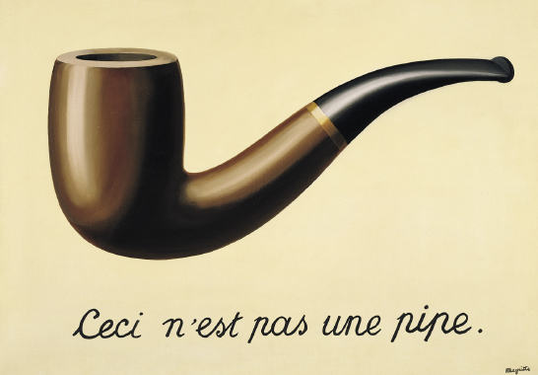
Quick recap - representation
IES differentiates between things and their representations – e.g. a pipe and a picture of a pipe
The same pattern is always used for representation
Names (and identifiers) can be qualified using naming schemes
Naming schemes can be associated with systems and/or organisations that use/own them
Naming schemes can be organised into hierarchies

Slide 41
Big Recap – It’s like Lego™
It’s worth pointing out at this point that you already know about the major building blocks for IES. You can identify things, talk about how they change over time, and specify what their type is. You can describe how things interact, where they are / were, and when it all happened to a degree of accuracy that you choose whilst still being specific about how accurate you were.
All this is done using very simple, repeatable patterns that are also additive – i.e. you usually don’t have to break your existing data to add more information / detail. Those simple patterns probably cover 80% of the data you’ll ever deal with.
Like the major blocks in Lego™, you can produce a reasonable model of anything you want using just these components. The rest of IES is about the more specialist blocks that allow you to deal with the details.

Slide 42
Worked Example - Hospital
Patients have names and NHS IDs. They go in and out of treatment, and stay in hospital beds in Wards.
Fred
University Hospital
Ward 1
Bed 101
s1
s2
2014-01-04T19:00
2014-01-04T9:00
2014-01-04T21:00
2014-01-05T11:00
Theatre A
ep1
Fred arrives at 9:00 on 4/1 and is put in bed 101. He then goes into theatre at 19:00 and returns to bed 101 at 21:00. He is discharged at 11:00 the next day.

Slide 43
Hospital Structure
The theatre and Ward are located in (part of) the Hospital. The bed is located in the Ward.
Two things to note. Firstly, beds can move, but for simplicity here we just say the bed has always been located in Ward1. Secondly, we used a model extension here. IES doesn’t define any more detail than parts of facilities, so we extend it to include data:HospitalBed

Slide 44
Fred’s States
This bit covers Fred’s movement around the hospital
Three states (one is an EventParticipant), and each has start and end BoundingStates. The BoundingStates are in Particular Periods, and the PersonStates are in Locations.

Slide 45
Complete Example
Notice we’ve added in the name and NHS number

Slide 46
RDF Triples serialized as N3
@prefix rdf: <http://www.w3.org/1999/02/22-rdf-syntax-ns#> .
@prefix rdfs: <http://www.w3.org/2000/01/rdf-schema#> .
@prefix ies: <http://ies.data.gov.uk/ies4#> .
@prefix data: <http://data.gov.uk/testdata#> .
@prefix iso8601: <http://iso.org/iso8601#> .
data:NHS a ies:GovernmentOrganisation .
data:nhsNumber a ies:NamingScheme .
data:fredNHSNum a ies:NationalIdentityNumber .
data:Fred a ies:Person .
data:fredName a ies:PersonName .
data:s1 a ies:PersonState .
data:s2 a ies:PersonState .
data:bs1 a ies:BoundingState .
data:bs2 a ies:BoundingState .
data:bs3 a ies:BoundingState .
data:bs4 a ies:BoundingState .
data:bs5 a ies:BoundingState .
data:bs6 a ies:BoundingState .
data:ep1 a ies:EventParticipant .
iso8601:2014-01-04T09:00 a ies:ParticularPeriod .
iso8601:2014-01-04T19:00 a ies:ParticularPeriod .
iso8601:2014-01-04T21:00 a ies:ParticularPeriod .
iso8601:2014-01-05T11:00 a ies:ParticularPeriod .
data:theatreA a ies:PartOfFacility .
data:UniversityHospital a ies:Facility .
data:Ward1 a ies:PartOfFacility .
data:bed101 a ies:PartofFacility
data:bed101 a data:HospitalBed .
data:HospitalBed a rdfs:Class .
data:HospitalBed rdfs:subClassOf ies:PartOfFacility .
data:nhsNumber ies:schemeOwner data:NHS .
data:fredNHSNum ies:inScheme data:nhsNumber .
data:fredNHSNum ies:representationValue "12AB3456789" .
data:Fred ies:isIdentifiedBy data:fredNHSNum .
data:fredName ies:representationValue "Fred Smith" .
data:Fred ies:hasName data:fredName .
data:s1 ies:isStateOf data:Fred .
data:s2 ies:isStateOf data:Fred .
data:ep1 ies:isParticipationOf data:Fred .
data:bs1 ies:isStartOf data:s1 .
data:bs1 ies:inPeriod iso8601:2014-01-04T09:00 .
data:bs2 ies:isEndOf data:s1 .
data:bs2 ies:inPeriod iso8601:2014-01-04T19:00 .
data:bs3 ies:isStartOf data:ep1 .
data:bs3 ies:inPeriod iso8601:2014-01-04T19:00 .
data:bs4 ies:isEndOf data:ep1 .
data:bs4 ies:inPeriod iso8601:2014-01-04T21:00 .
data:bs5 ies:isStartOf data:s2 .
data:bs5 ies:inPeriod iso8601:2014-01-04T21:00 .
data:bs6 ies:isEndOf data:s2 .
data:bs6 ies:inPeriod iso8601:2014-01-05T11:00 .
data:ep1 ies:inLocation data:theatreA .
data:theatreA ies:inLocation data:UniversityHospital .
data:Ward1 ies:inLocation data:UniversityHospital .
data:bed101 ies:inLocation data:Ward1 .
data:s1 ies:inLocation data:bed101 .
data:s2 ies:inLocation data:bed101 .

Slide 47
…and as JSON-LD
"hasParticipations":[
{
"@id":"ep1",
"@type":"ies:EventParticipant",
"ies:inLocation":{"@id":"theatreA"},
"startState":{
"@id":"bs3",
"@type":"ies:BoundingState",
"ies:inPeriod":{"@id":"iso8601:2014-01-04T19:00"}
},
"endState":{
"@id":"bs4",
"@type":"ies:BoundingState",
"ies:inPeriod":{"@id":"iso8601:2014-01-04T21:00"}
}
}
]
},
{
"@id":"iso8601:2014-01-04T09:00",
"@type":"ies:ParticularPeriod"
},
{
"@id":"iso8601:2014-01-04T19:00",
"@type":"ies:ParticularPeriod"
},
{
"@id":"iso8601:2014-01-04T21:00",
"@type":"ies:ParticularPeriod"
},
{
"@id":"iso8601:2014-01-05T11:00",
"@type":"ies:ParticularPeriod"
},
{
"@id":"theatreA",
"@type":"ies:PartOfFacility",
"ies:inLocation":{ "@id":"UniversityHospital"}
},
{
"@id":"Ward1",
"@type":"ies:PartOfFacility",
"ies:inLocation":{"@id":"UniversityHospital"}
},
{
"@id":"bed101",
"@type":["ies:PartOfFacility","HospitalBed"],
"ies:inLocation":{"@id":"Ward1"}
},
{
"@id":"HospitalBed",
"@type":"rdfs:Class",
"rdfs:subClassOf":
{
“@id”:"ies:PartOfFacility“
}
},
{
"@id":"UniversityHospital",
"@type":"ies:Facility"
}
]
}
{
"@context": { //this is the bit that maps the RDF constructs onto simple JSON keys
"@base":"http://data.gov.uk/testdata#",
"name": "http://ies.data.gov/ies4#hasName",
"iso8601":"http://iso.org/iso8601#",
"ies": "http://ies.data.gov/ies4#",
"rdfs": "http://www.w3.org/2000/01/rdf-schema#",
"hasStates" : {"@reverse":"http://ies.data.gov/ies4#isStateOf"}, //note reversal of predicate direction !!!
"startState" : {"@reverse":"http://ies.data.gov/ies4#isStartOf"},
"endState" : {"@reverse":"http://ies.data.gov/ies4#isEndOf"},
"hasParticipations" : {"@reverse":"http://ies.data.gov/ies4#isParticipationOf"}
},
"@graph": [
{
"@id":"Fred",
"@type":"ies:Person",
"ies:hasName":{
"ies:representationValue":"Fred Smith“,
"@id":"fredName",
"@type":"ies:PersonName",
},
"ies:isIdentifiedBy":{
"ies:representationValue":"12AB3456789",
"@id":"fredNHSNum",
"@type":"ies:NationalIdentityNumber",
"ies:inScheme":{
"@id":"nhsNumber",
"@type":"ies:NamingScheme",
"ies:schemeOwner":
{
"@id":"NHS",
"@type":"ies:GovernmentOrganisation"
}
}
},
"hasStates":[
{
"@id":"s1",
"@type":"ies:PersonsState",
"ies:inLocation":{"@id":"bed101"},
"startState":{
"@id":"bs1",
"@type":"ies:BoundingState",
"ies:inPeriod":{"@id":"iso8601:2014-01-04T09:00"}
},
"endState":{
"@id":"bs2",
"@type":"ies:BoundingState",
"ies:inPeriod":{"@id":"iso8601:2014-01-04T19:00"}
}
},
{
"@id":"s2",
"@type":"ies:PersonsState",
"ies:inLocation":{"@id":"bed101"},
"startState":{
"@id":"bs5",
"@type":"ies:BoundingState",
"ies:inPeriod":{"@id":"iso8601:2014-01-04T21:00"}
},
"endState":{
"@id":"bs6",
"@type":"ies:BoundingState",
"ies:inPeriod":{"@id":"iso8601:2014-01-05T11:00"}
}
}
],
JSON-LD sacrifices readability in order to provide a hierarchical structure. Note use of @reverse in the @context section – this allows some predicates to be reversed so the graph can be shaped into a JSON hierarchy for presentation as REST payloads, but re-assembled into a graph for RDF purposes.

